Slide 1
Staying safe online during a time of home learning.
M Mannas

Slide 2
Online scams

Slide 3
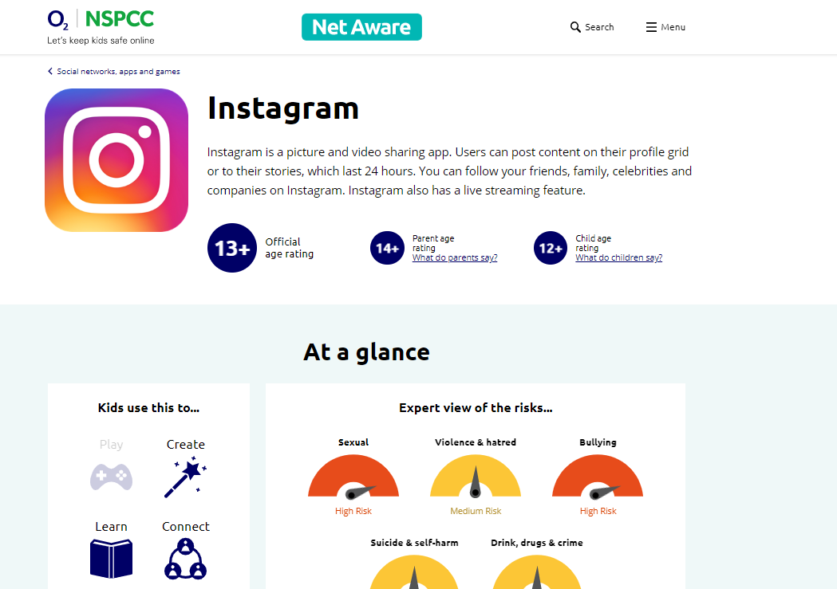
Net aware

Slide 4
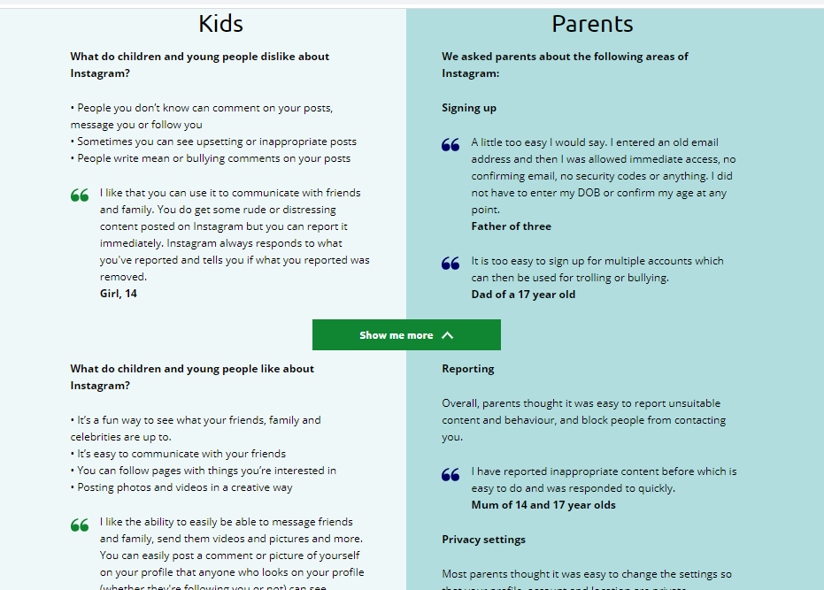
Net aware

Slide 5
Be safe online
Know who are you talking to
Profiles
keep it private
don’t share personal information
Photos/Videos
be careful
not in/from school
Think before you post

Slide 6
Be safe online
Know who are you talking to
Profiles
keep it private
don’t share personal information
Photos/Videos
be careful
not in/from school
Think before you post

Slide 7
Be safe online
Know who are you talking to
Profiles
keep it private
don’t share personal information
Photos/Videos
be careful
not in/from school
Think before you post

Slide 8
Social networking “friends”
51% of year 8 students have accepted a friend request from someone they didn’t know.
30% of year 8 students have requested to be friends with someone they don’t know.

Slide 9
Be safe online
Know who are you talking to
Profiles
keep it private
don’t share personal information
Photos/Videos
be careful
not in/from school
Think before you post

Slide 10
Location services

Slide 11
Sexting...what is it?
Sexting is when somebody uses their mobile to send an inappropriate image to other people.

Slide 12
The Law – on sexting
Under British law it is legal to have sex aged 16, but it is illegal and a serious criminal offence to take, hold or share "indecent" photos of anyone aged under 18.
Those breaking the law could be prosecuted and be placed on the Sex Offenders Register.

Slide 13
Be safe online
Know who are you talking to
Profiles
keep it private
don’t share personal information
Photos/Videos
be careful
not in/from school
Think before you post

Slide 14
Derogatory/hurtful posts
29% of year 8 students have posted derogatory or hurtful
comments about someone else
56 % say they have had something posted about them
which was derogatory or hurtful

Slide 15
What is Cyberbullying?
Cyberbullying (or online bullying) is using modern communication technology to deliberately and repeatedly harass, humiliate, embarrass, torment, threaten, pick on or intimidate someone.

Slide 16
